Slide 1


Exposure CS 2022
for CS1
Chapter 7
Output Slides
For Students
PowerPoint Presentation
created by:
Mr. John L. M. Schram
and Mr. Leon Schram
Authors of Exposure
Computer Science

Slide 2
Output Programs
These slides will present a variety of small programs. Each program example either has a selection control structure or some type of numeric formatting.
Our concern will be with the output of each program, and more importantly, developing a way to determine program output correctly for programs that involve selection control structures and numeric formatting.
You can expect that on quizzes and/or tests that only a program segment may be shown.

Slide 3

Teacher/Student Versions, Tablet PCs, and Inking
The “For Teachers” version of this presentation has 2 or more slides for each program.
The first slide only shows the program.
The other slide(s) show the program, worked out solution, and output.
The “For Students” version
only has 1 slide for each
program with no provided
solution or output. Students are
expected to work out the solutions either on paper, or ideally they can “ink” directly on their laptops.

Slide 4
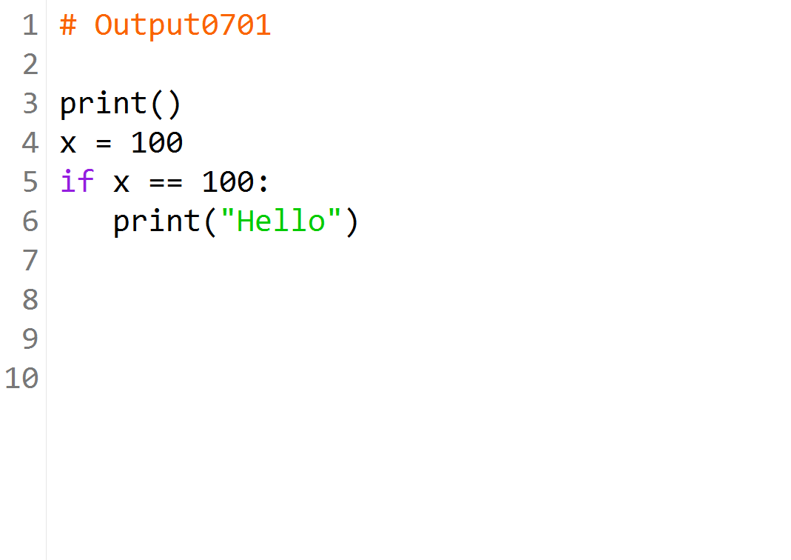

Slide 5


Slide 6
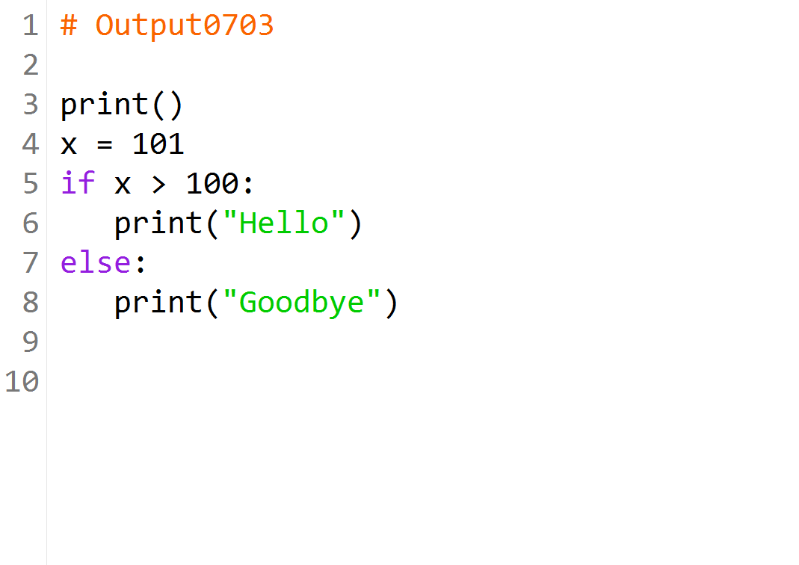

Slide 7
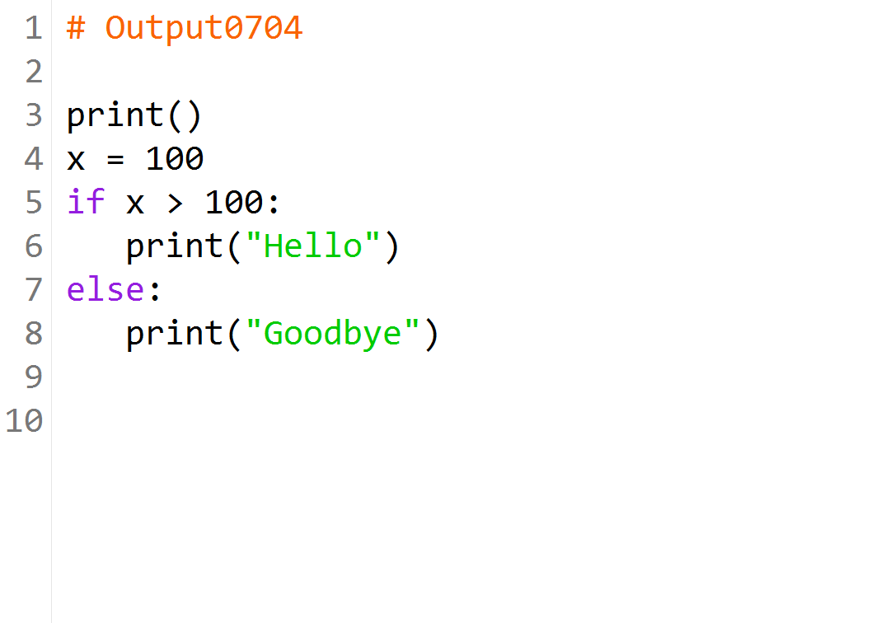

Slide 8
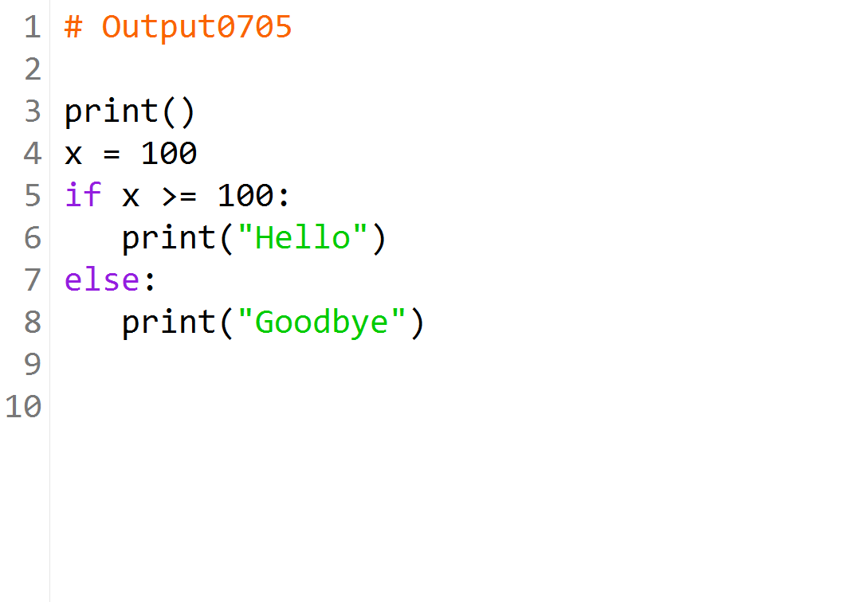

Slide 9
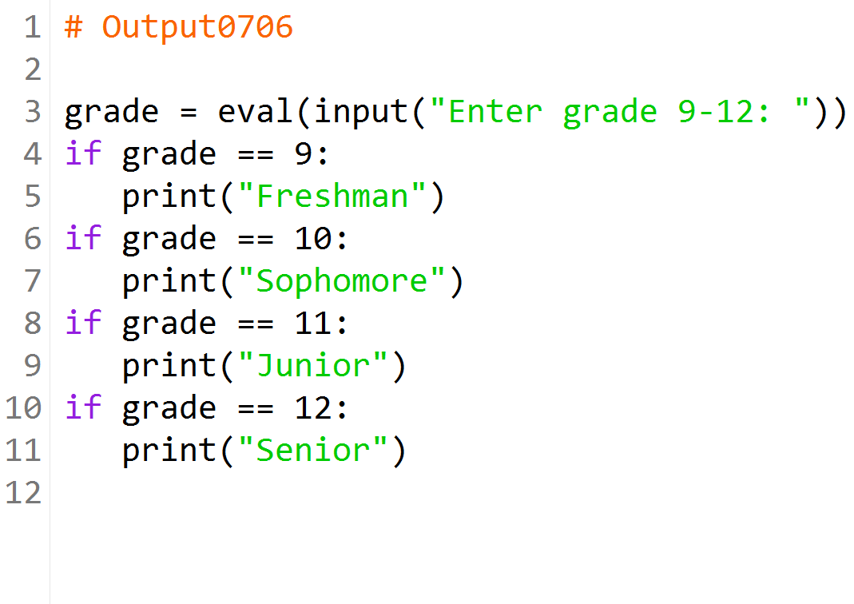
What is the output after the user enters 10?

Slide 10
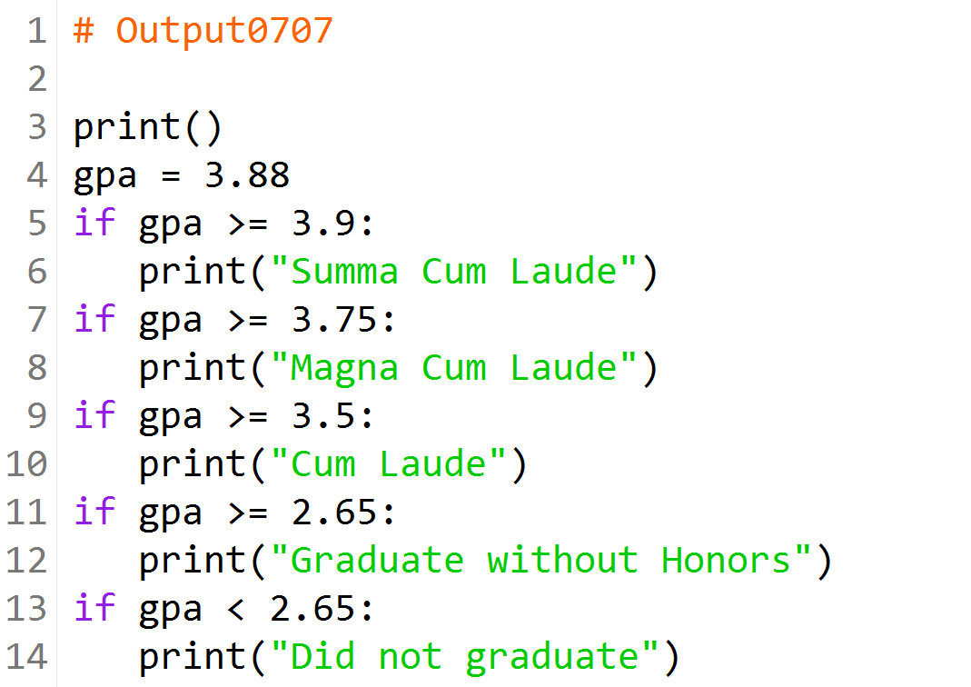

Slide 11
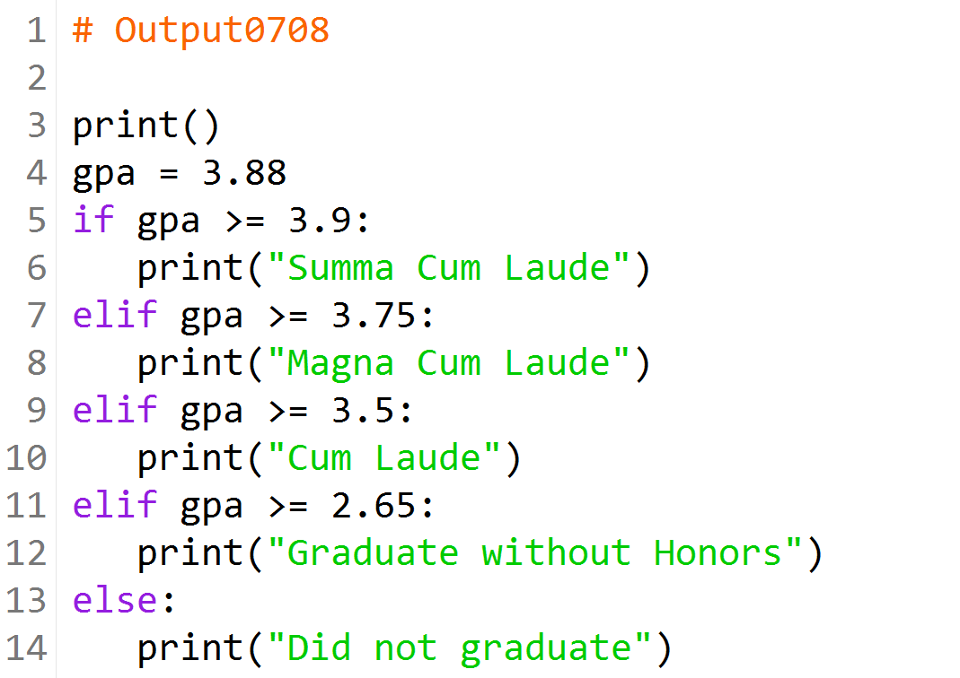

Slide 12
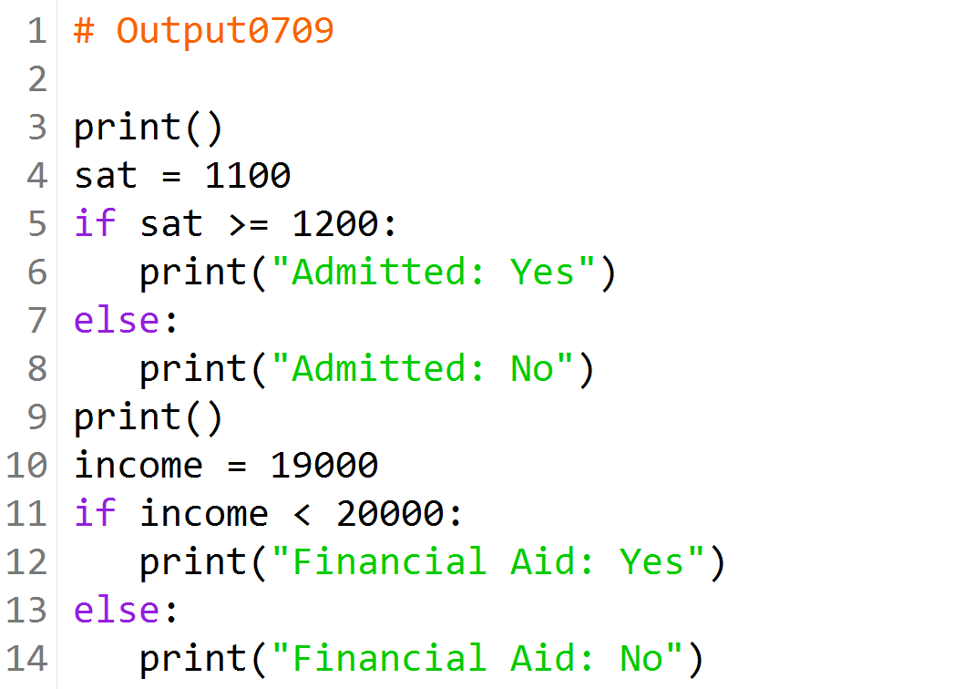

Slide 13
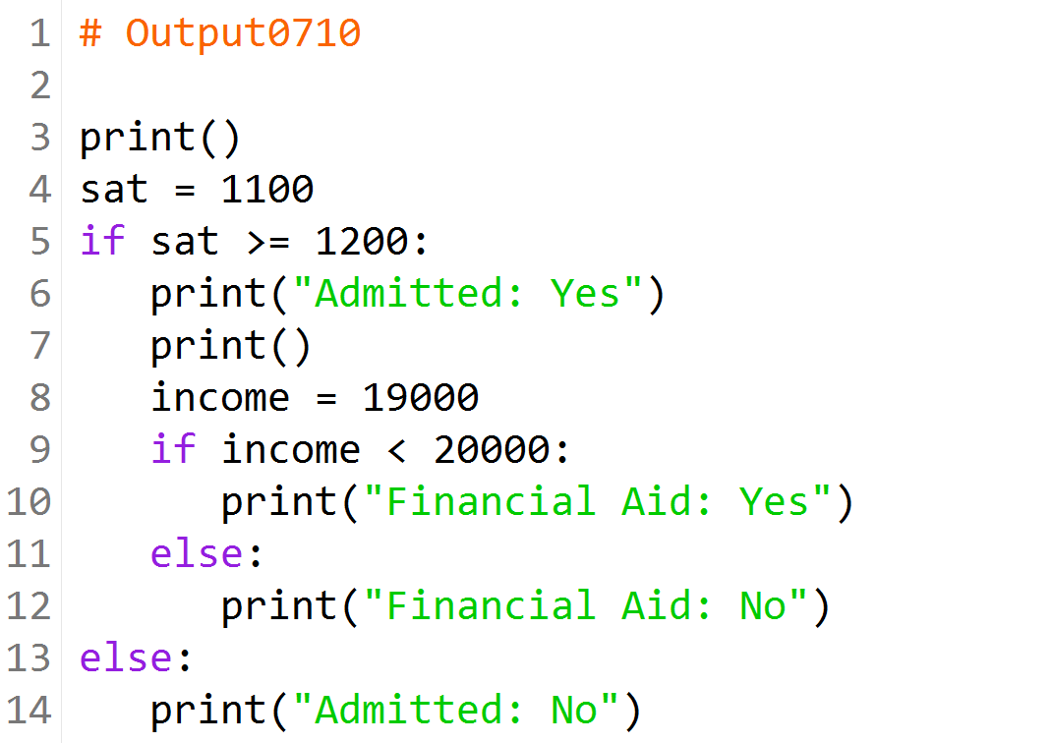

Slide 14
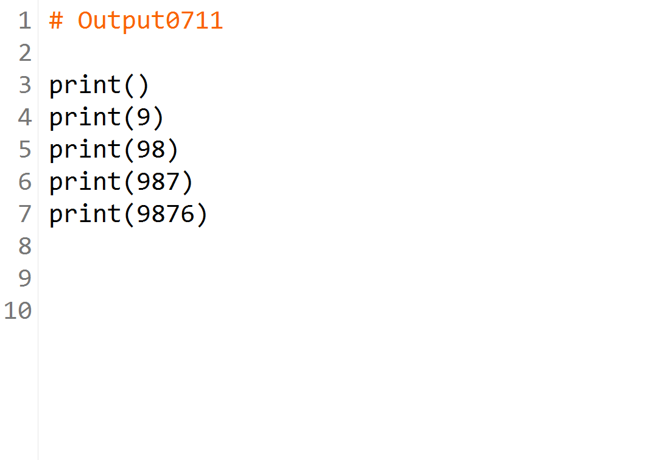

Slide 15
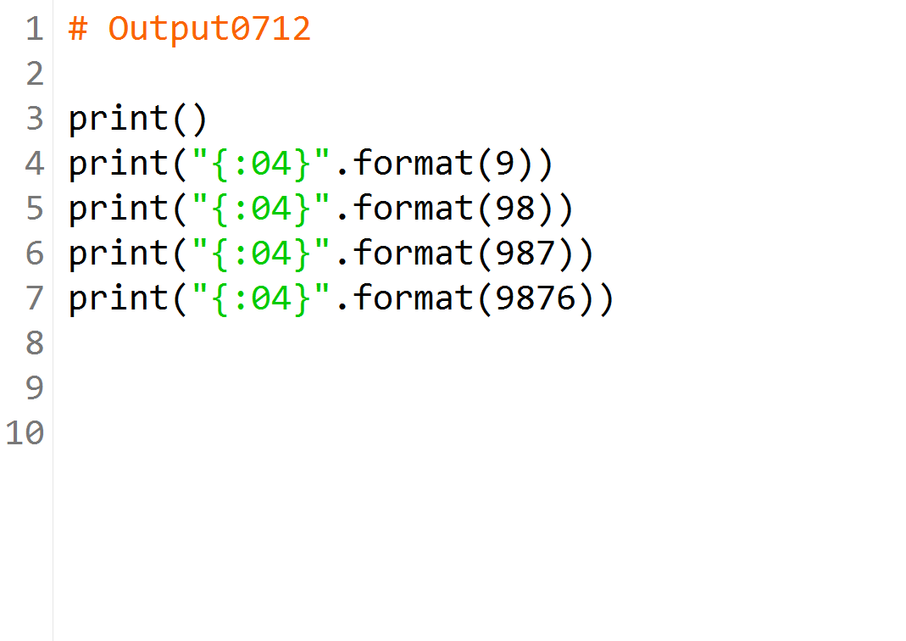

Slide 16


Slide 17
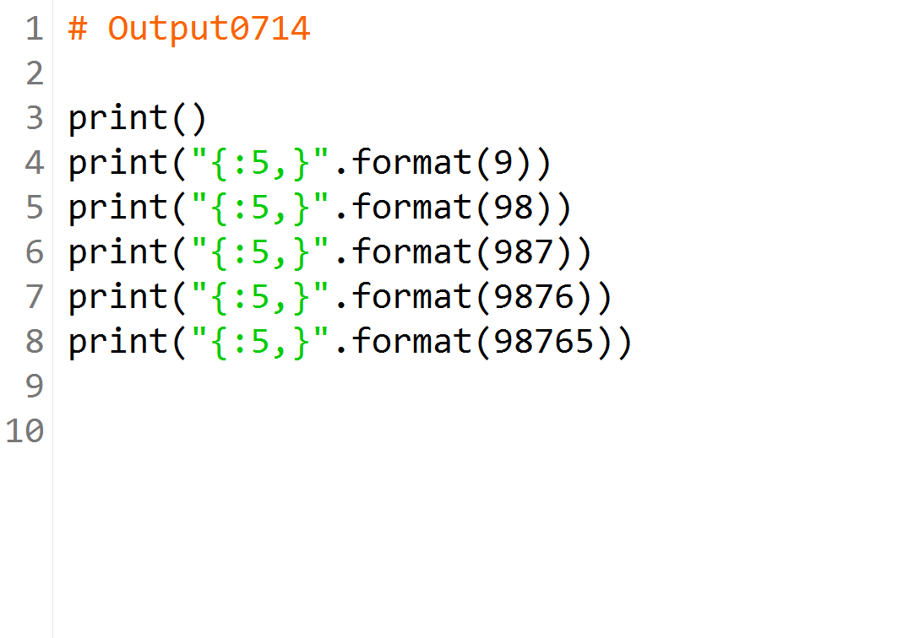

Slide 18
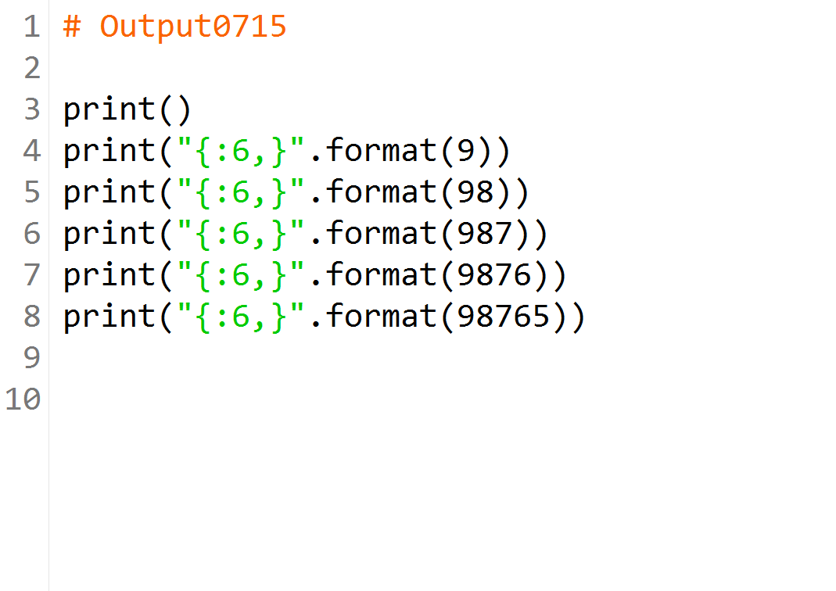

Slide 19
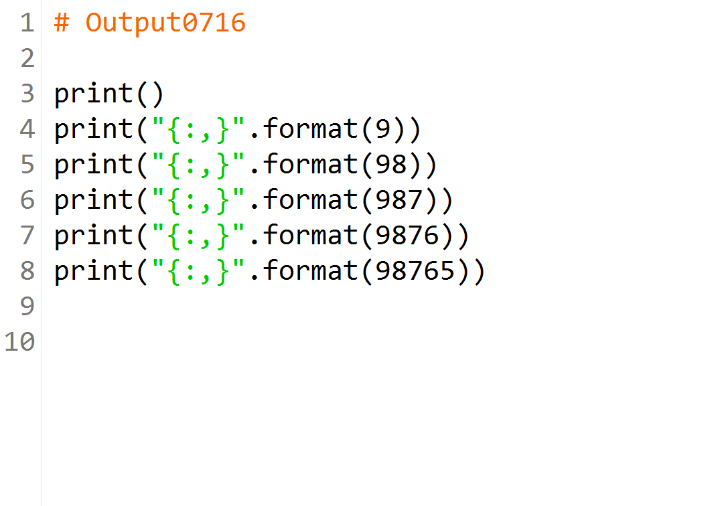

Slide 20
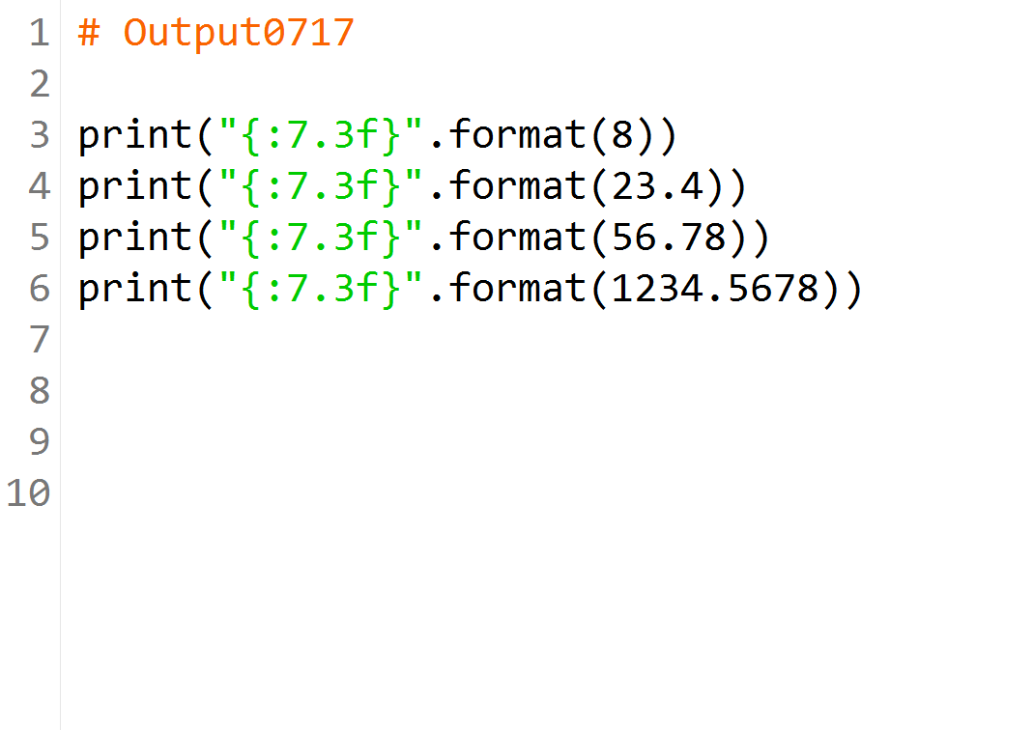

Slide 21
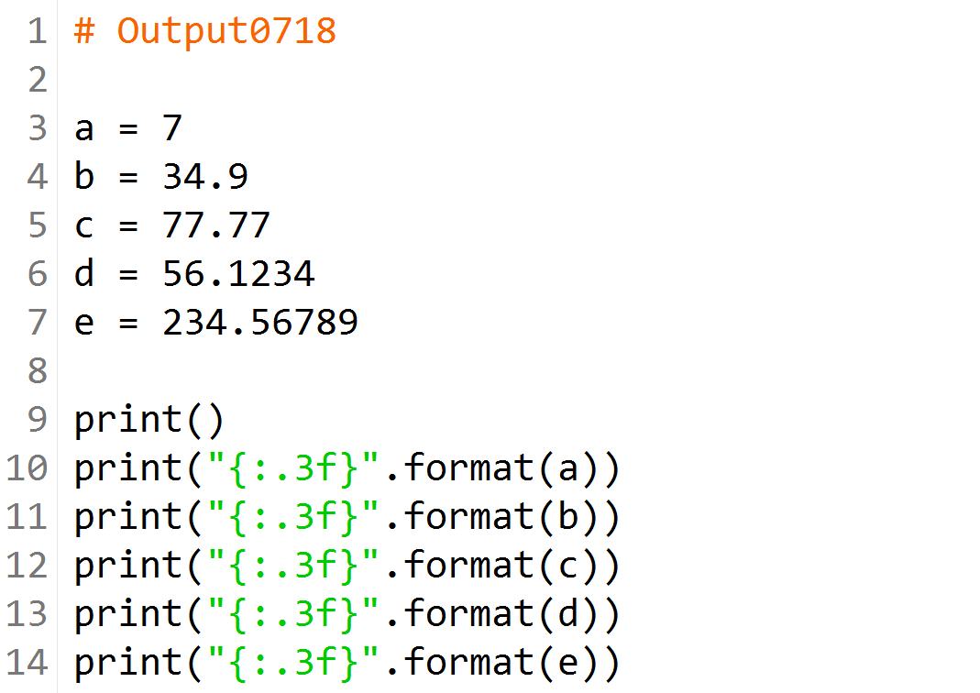

Slide 22
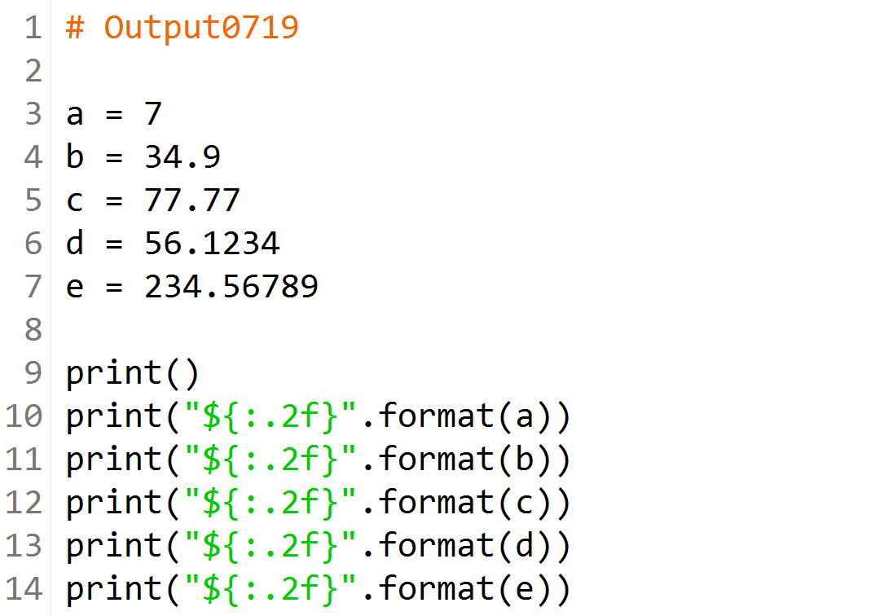

Slide 23
